Slide 1
Application Components
CSE11 - Chapter 3

Slide 2
Topic Overview
Application Components
The Activity Class
Activity Life Cycle

Slide 3
Application Components
Essential building blocks of an Android app.
Each component is an entry point through which the system or a user can enter the app.
Some components of Android are dependent from each other.

Slide 4
Application Components
Activities
Services
Broadcast receivers
Content providers

Slide 5
Application Components
Activities
An activity represents a single screen with a user interface,
In-short Activity performs actions on the screen.
For example, an email application might have one activity that shows a list of new emails, another activity to compose an email, and another activity for reading emails.
If an application has more than one activity, then one of them should be marked as the activity that is presented when the application is launched.

Slide 6
Application Components
Broadcast Receivers
Broadcast Receivers simply respond to broadcast messages from other applications or from the system.
For example, applications can also initiate broadcasts to let other applications know that some data has been downloaded to the device and is available for them to use, so this is broadcast receiver who will intercept this communication and will initiate appropriate action.

Slide 7
Application Components
Content Providers
A content provider component supplies data from one application to others on request.
Such requests are handled by the methods of the ContentResolver class.
The data may be stored in the file system, the database or somewhere else entirely.

Slide 8
Application Components
Services
A service is a component that runs in the background to perform long-running operations.
For example, a service might play music in the background while the user is in a different application, or it might fetch data over the network without blocking user interaction with an activity.

Slide 9
Activity Class
The Activities are the main Java classes that contain the logic with which the application operates on
An Android activity is usually one screen of the Android app's user interface
An Android app may contain one or more activities, meaning one or more screens.
The Android app starts by showing the main activity, and from there the app may make it possible to open additional activities.

Slide 10
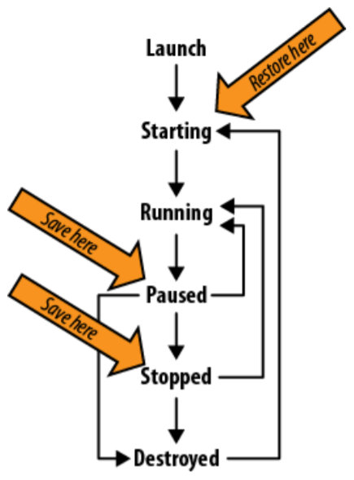
Activity Life Cycle
Starting – the activity is not in memory
Running – the activity is active and may interact with the user
Paused – the activity is not in focus
Stopped – the activity is not visible, but still in memory
Destroyed – the activity is no longer in memory
Notes:
Informal discussion:
Apps have their different states, from opening the app to closing the app
The following is the life cycle of an Android app.
*Upon opening the app (tapping the app), the loading phase of your app is the starting state as it is getting ready to load the app to the memory
*The running state means that the app has launched successfully and is active and you can now interact with it (normally, you can already see the homepage of the app in this state)
*Similar to minimizing software in your desktop, the paused phase is when the user leaves the activity, the app will no longer be in the foreground but still running in the background (This does not indicate that the app is destroyed).
*The stopped state is when the activity is no longer visible but is still in the memory. This normally occurs when the app is being destroyed or in your app, you have another activity prompted thus stopping the current running state of the current activity.
*Destroyed is destroying the activity, meaning the activity will no longer be seen and is no longer in the memory.
For the Save here arrows, make sure that you save the current state of the app before pausing or stopping the app.
The restore arrow indicates that if ever the app crashes or manually destroyed, It will go to the starting state once runned again.

Slide 11
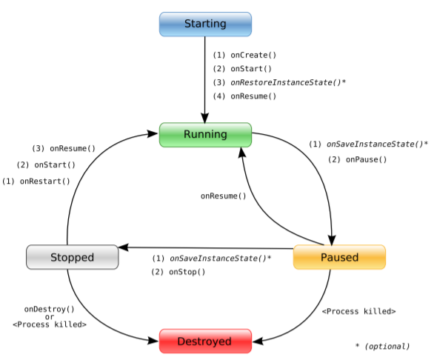
Activity Life Cycle Methods

Slide 12
Activity Life Cycle Methods
onCreate(Bundle): This is called when the activity first starts up. You can use it to perform one-time initialization such as creating the user interface. onCreate( ) takes one parameter that is either null or some state information previously saved by the onSaveInstanceState( ) method.
onStart( ): This indicates the activity is about to be displayed to the user
onResume( ): This is called when your activity can start interacting with the user. This is a good place to start animations and music.

Slide 13
Activity Life Cycle Methods
onPause( ): This runs when the activity is about to go into the background, usually because another activity has been launched in front of it. This is where you should save your program’s persistent state, such as a database record being edited.
onStop( ): This is called when your activity is no longer visible to the user and it won’t be needed for a while. If memory is tight, onStop( ) may never be called (the system may simply terminate your process).
onRestart( ): If this method is called, it indicates your activity is being redisplayed to the user from a stopped state.

Slide 14
Activity Life Cycle Methods
onDestroy( ): This is called right before your activity is destroyed. If memory is tight, onDestroy( ) may never be called (the system may simply terminate your process).
onSaveInstanceState(Bundle): Android will call this method to allow the activity to save per-instance state, such as a cursor position within a text field. Usually you won’t need to override it because the default implementation saves the state for all your user interface controls automatically.
onRestoreInstanceState(Bundle): This is called when the activity is being reinitialized from a state previously saved by the onSaveInstanceState( ) method. The default implementation restores the state of your user interface.

